Slide 1






Implementing VPN Solutions With
FortiGate

Slide 2

AGenda
About us
Introduction
Chapter 1
Chapter 2
Chapter 3

Slide 3






About us
Mohab Nasser
Ahmed Khaled
Amr khaled
Youssef Mohamed
Computer Science
October 6 University
Computer Science
Sadat Academy
Computer Science
Cairo University
Computer Science
Sadat Academy

Slide 4


Introduction
Secure Data Transmission
VPN encrypts your internet traffic, protecting sensitive data from hackers, ISPs, and cyber threats.
Why use VPN ?
Remote Access
Employees can safely access company networks and resources from anywhere in the world.
Privacy & Anonymity
VPN hides your IP address, keeping your online activities private from websites, trackers, and advertisers.
Bypass Geo-Restrictions & Censorship
Access content or services that may be restricted in your country or region.

Slide 5

Introduction
Types Of VPN
Remote Access
Site To Site
Ipsec
Allows individual users to connect to a private network remotely over the internet.
Uses:
Employees working from home
Students accessing university resources
Secure access to company files and applications
Connects two networks together over the internet (network-to-network).
Uses:
Connecting branch offices with HQ
Linking data centers
Secure internal communication between company locations
IPsec for encrypted communication between endpoints or networks.
Uses:
Site-to-site VPNs
Client-to-site VPNs
High-security environments

Slide 6

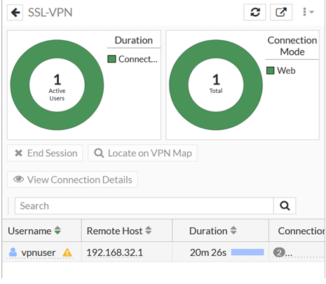
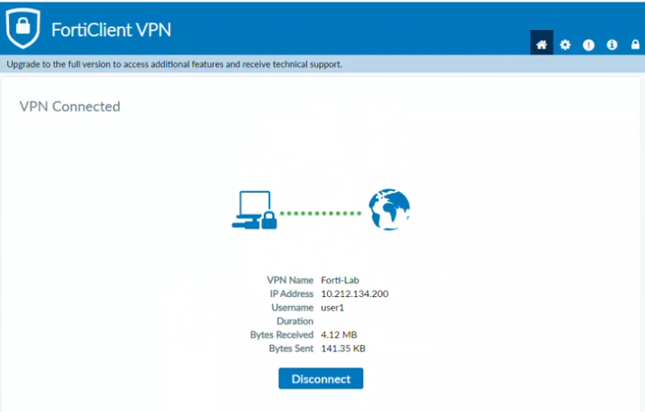
Chapter 1
SSL VPN Configuration
WEB MODE
Tunnel Mode
Access : Through a web browser only no client software required.
Functionality : Provides access to specific applications like internal email, files, or company web portals.
Control : Access is restricted and limited to certain resources.
Ease of Use : Simple and quick for employees who need access to specific apps.
Example : Opening the company intranet or a file management app directly from a browser.
Access : Through a VPN client
(e.g., FortiClient), creating a secure tunnel to the network.
Functionality : Connects you to the entire internal network as if you were on-site.
Control: Full access to all network resources, not just specific apps.
Complexity : Requires installing client software, but offers more flexibility and control.
Example : Connecting your device to the internal company network to access printers, databases, or servers.

Slide 7

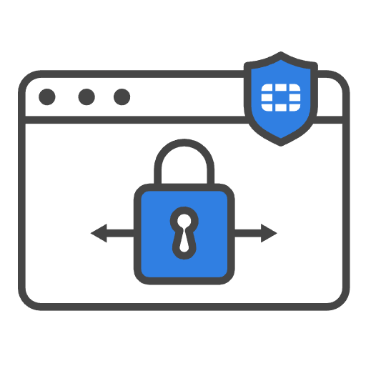

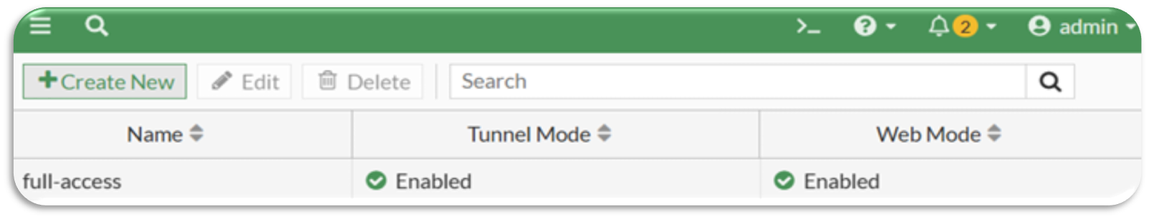
Full ACCESS
Chapter 1
Full access in SSL VPN allows the user to connect to the entire internal network of the organization, as if they were physically on-site.
Key Points : VPN Client Required: Usually requires FortiClient or another SSL VPN client.
Complete Network Reachability : Users can access all LAN resources—servers, printers, databases, and applications—not just specific web apps.
Secure Encrypted Tunnel : All traffic between the remote user and the internal network is encrypted, ensuring confidentiality.
Flexibility & Productivity : Ideal for employees who need full resources for their daily work, not limited to a few applications.
Comparison to Web Mode :
Web Mode : Limited access to certain applications via browser.
Full Access : Full network connectivity through a secure tunnel.
Example : A remote engineer accessing internal file servers, email servers, and intranet tools simultaneously via SSL VPN tunnel.

Slide 8
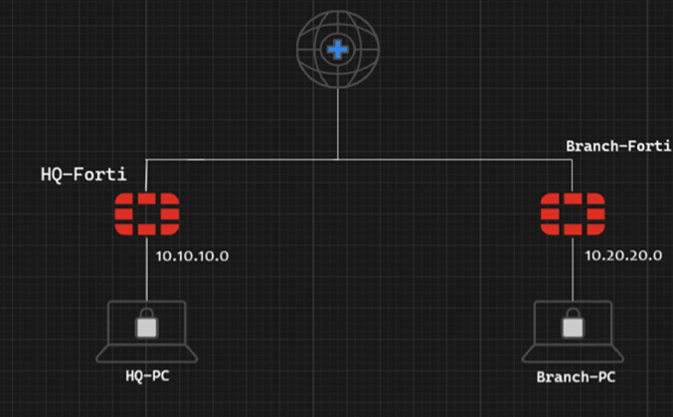
Chapter 2
IPsec VPN Configuration
Establish a secure VPN tunnel Between to Branches
Phase 1 IKE : Pre-shared Key, IKEv2, DES Encryption, SHA384, DH Group 14, Key Lifetime 86400s.
Phase 2 Ipsec : Local/Remote Subnets, DES Encryption, SHA256, Replay Detection enabled.
Connectivity Tests

Slide 9

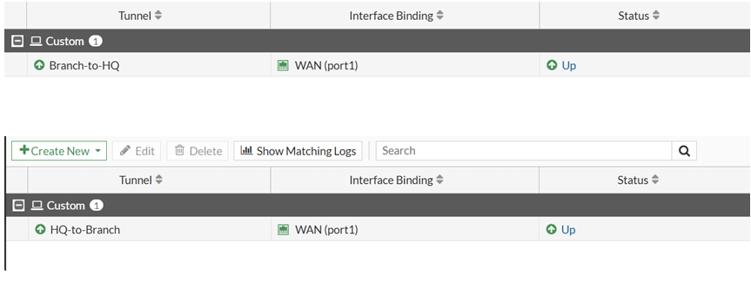
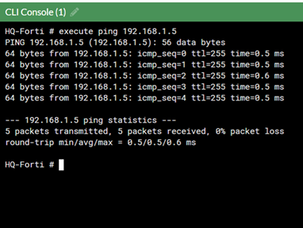
Chapter 2
IPsec VPN tunnel successfully established between HQ and Branch FortiGates.
Secure, encrypted communication enabled between remote LANs.
Demonstrated both ICMP (ping) and application-layer (SCP) traffic.
Configuration follows security best practices for integrity and confidentiality.
PAGE 9

Slide 10
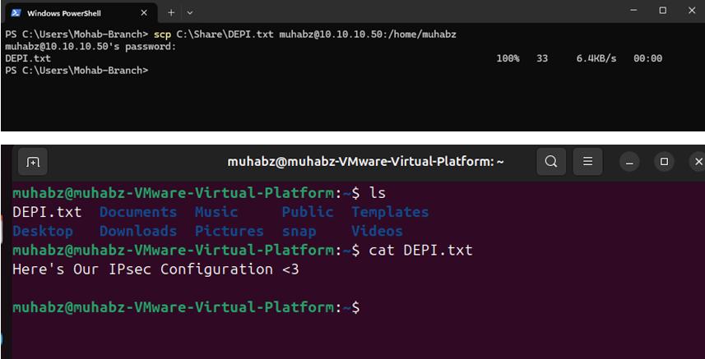
thynk unlimited
Connectivity Test
Test 2: File Transfer Test (SCP Protocol)

Slide 11
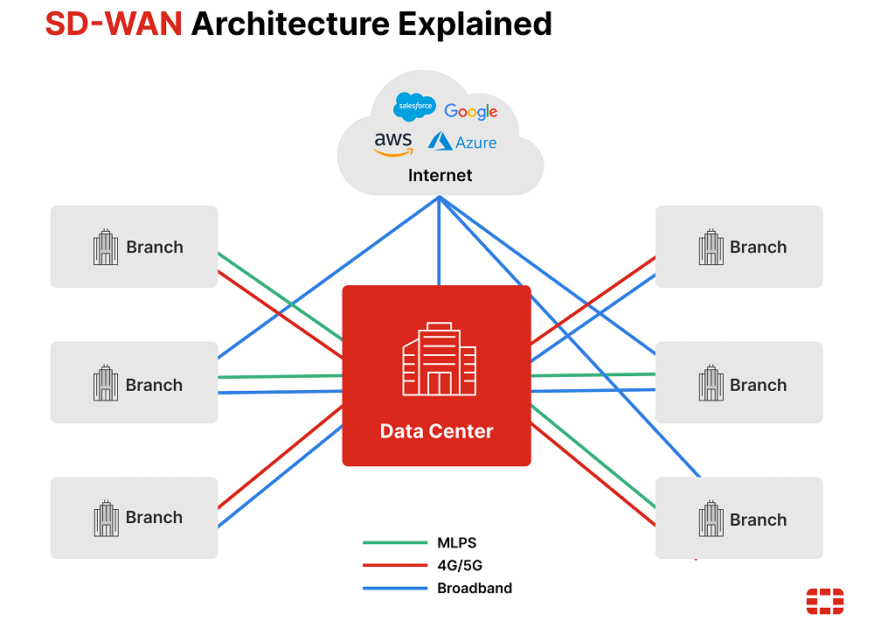
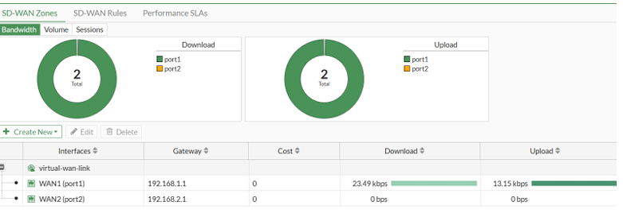
Chapter 3
SD-WAN Implementation
Purpose: Combine multiple internet links for smart traffic distribution, load balancing, and automatic failover.
Benefits of VPN + SD-WAN
Secure communication between remote networks and users.
Optimized internet and application performance.
High availability and automatic failover.
Centralized monitoring and proactive network management.

Slide 12
Chapter 3
Configuration Highlights
Members
zones
Added WAN1 & WAN2 as SD-WAN members under SD-WAN-Zone.
Configured performance SLA for latency, jitter, and packet loss monitoring.
Created application aware routing rules (VoIP,YouTube,web). Load balancing:
Source-IP based.

Slide 13


ENDING
Connecting securely
Secure & Reliable Connectivity : VPN (SSL & IPsec) ensures encrypted communication for users and sites.
Optimized Network Performance : SD-WAN intelligently distributes traffic, balances load, and provides failover.
Enhanced Productivity : Users can access resources securely from anywhere, and applications perform better.
Proactive Management : Real-time monitoring enables quick detection of issues and ensures high availability.

Slide 14


ENDING
Thank You!
Thank you for your attention! Stay safe and secure online every day.

